Slide 1
TDD - Rediscovered
The Fallacies and Principles of Effective TDD

Slide 2
Who are you?
Software Developer for more than 20 years
Worked mainly for ISVs
Reuters, SunGard, Misys, Huddle
Worked for a couple of MIS departments
DTI, Beazley
Microsoft MVP for C#
Interested in architecture and design
Interested in Agile methodologies and practices
No smart guys
Just the guys in this room

Slide 3
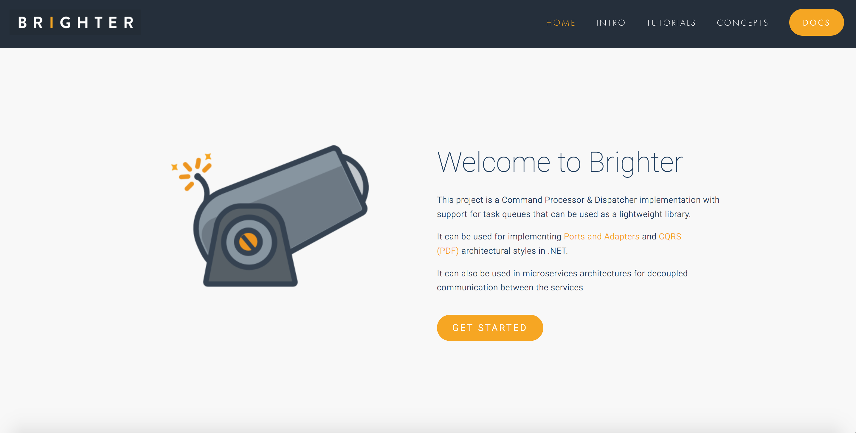

Slide 4
Agenda
Developers write Tests (120)
A Walk Through Unit Testing
Fallacies and Principles
A Walk Through Developer Testing
Break and Q&A (10/10)
Towards Clean Code (30)
Revisiting Red-Green-Refactor
A Walk Through Refactoring
Clean Architecture
A Walk Through Clean Architecture
Are we done yet? (15)
Fallacies and Principles
A Walk Through Feature Testing
A Walk Through Developer Testing
First, Last and Everything (15)
Fallacies and Principles
Break and Q&A (10/10)
Summary (5)
Optional: Kata: Game of Life (25)

Slide 5
The Problem

Slide 6
Some good developers don’t want to write tests.
Why? They are not idiots.

Slide 7
We often write more test code than implementation code.
There may be a reason why some complain that adding tests is robbing us of productivity

Slide 8
When we change implementation details we break tests, often dozens.
Didn’t refactoring promise change without breaking tests?

Slide 9
Why do approaches like “Programmer Anarchy”, “Spike and Stabilize”, and “Lean Software Development” want to drop test first.
They see Test First approaches as unproductive – as obstacles to development

Slide 10
Why is the ‘duct tape programmer’ winning?
They deliver functionality to customers faster, and quickly abandon tests as ‘slowing them down’

Slide 11
When we return to our tests – because they are broken it is often difficult to understand their intent
Is it broken because the behavior has changed? Where is that behavior expressed?

Slide 12
We have large ATDD suites written in Fit or Gherkin
They spend much of their life red

Slide 13
Customers don’t engage with our ATDD suites
And yet we spend a lot of time maintaining them

Slide 14
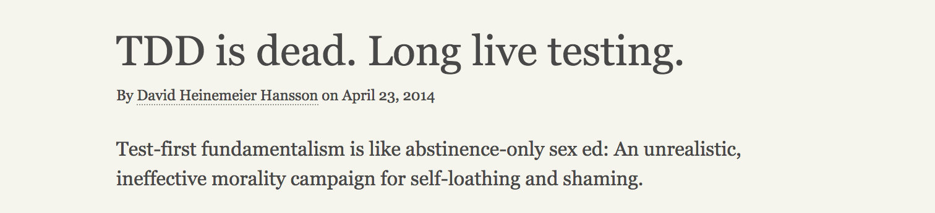

Slide 15
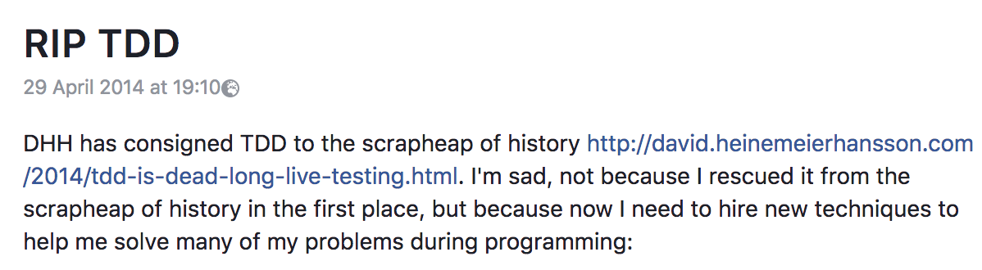
Kent Beck

Slide 16
Developers Write Tests

Slide 17
A Walk Through Unit Testing

Slide 18
We assume you are familiar with Red-Greed-Refactor, but we will run through it's details again later. For now here is a quick summary.

Slide 19
Red: Write a failing test
Green: Make the test pass
Refactor: Improve the code
TDD Cycle

Slide 20
In 1970, John Horton Conway created a zero-player game of cellular automation called life or Game of Life.
By zero-player we mean that given a starting position the game proceeds by evolution, not further input.
Each 'move' in the game is the application of a set of rules to the existing position to generate a new one.
The game is infinite, in that we can keep iterating. Patterns can emerge.

Slide 21
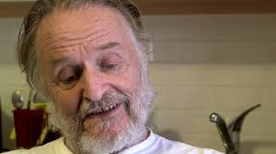
https://youtu.be/E8kUJL04ELA?start=65&end=229
John Conway, 26 December 1937 – 11 April 2020
Notes:
John Conway sadly died of COVID-19 in 2020
Play Conway video

Slide 22
The board is a two-dimensional grid of cells. Each cell has a state of either alive or dead.

Slide 23
With each iteration, we apply the following rules to determine the state of any cell.

Slide 24
Any live cell with two or three live neighbors survives.
Any dead cell with three live neighbors becomes a live cell.
All other live cells die in the next generation. Similarly, all other dead cells stay dead.

Slide 25
The initial pattern is called the seed. When a tick occurs, the rules are applied and we move from seed to first generation to second generation and so on.

Slide 26
Technically the board it is infinite, but for our purposes we will treat it as finite, and treat any cell location outside the border as dead for evaluation purposes. No life exists outside our 'universe.'

Slide 27
We are writing unit tests. The unit is a class and should be isolated from other classes.
The prompt to write a test is a new method. If we need a method, we write a test before we write the method.
* When we discover that we need collaborators our preference is to mock them, establishing their behaviour from the client, and then implement them with their own tests.

Slide 28
Fallacies and Principles

Slide 29
Developers write Unit Tests
Notes:
When engineers talk about TDD, they often associate it with the idea of a developer writing a unit test.
This fallacy has led to many of the problems with how TDD is practiced.

Slide 30
I call them “unit tests,” but they don't
match the accepted definition of unit tests very well
Kent Beck, TDD By Example
Notes:
In fact, Kent only uses the term unit test in this quote, and in a discussion of the problems of acceptance testing. Small-scale test is the alternative to unit test he suggests in the same paragraph. Nearly everywhere else Kent in his book Kent just says ‘test.’
Co-opting the word ‘unit test’ into our lexicon to describe what a developer writes in the TDD process has a number of problems, derived from the association with the principles of classical unit testing.

Slide 31
To isolate issues that may arise, each test case should be tested independently. Substitutes such as method stubs, mock objects, fakes, and test harnesses can be used to assist testing a module in isolation.
https://en.wikipedia.org/wiki/Unit_testing
Notes:
If we assume that TDD uses unit tests, that comes with some constraints that come from classical testing theory.
Unit tests isolate the module. To do that all dependencies of the module are replaced, for the test with a ‘test double’ a stub, fake or mock. The replacement should be predictable, so that we can isolate any failure to the unit under test, not its collaborators
Integration tests connect two modules together to determine if they can hook together.
System tests integrate all the modules and let us run end-to-end.
Typically, in OO TDD, the module is identified as a class. This means that we end up mocking all of the dependencies of our class

Slide 32
Need-driven Development [is a] variation on the test-driven development process where code is written from the outside in and all depended-on code is replaced by Mock Objects that verify the expected indirect outputs of the code being written.
Meszaros, Gerard. xUnit Test Patterns
Notes:
The assertion that we are doing “unit testing’ lead to the privileging of the idea that you should mock all the dependencies of the SUT, in order to isolate it. The cry was ‘defect localization’. We want to know what ‘failed’ and that means only one one test should fail for any given line of code, and if we include dependencies, how we will know it was our code and not a collaborator. So all or our collaborators will behave perfectly.
This idea, which Meszaros calls Need-Driven Development has all ‘dependencies’ replaced with a mock, often so that we define the interface of the collaborator when implementing the SUT.

Slide 33
Our need for Inversion of Control containers, over Poor Man’s DI is due to Need-Driven Development
Notes:
Our dependency on Inversion of Control containers, over Poor Man’s DI is often due to the complexity caused by our need to inject all of our dependencies over newing up a dependency in the constructor.
There are valid times to use injection:
* The Open-Closed Principle where we want to be closed to modification but open to extension by substituting variations of an interface that represent real run time variation, such as differing rules for an insurance policy
Where we need to use Dependency Inversion to satisfy the constraints of a layer boundary, such as depend inwards, to allow run-time replacement of what would otherwise be a cyclic dependency
But over-use in our classes simply to make them observable for testing has undesirable side-affects and makes our tests fragile.

Slide 34
When I look around now, I see a lot of people using mocks to replace all their dependencies. My concern is that they will begin to hit the Fragile Test issues that mocks present. Gerard Meszaros identifies the issues we hit as two specific smells: Overspecified Software and Behavior Sensitivity.
http://codebetter.com/iancooper/2007/12/19/mocks-and-the-dangers-of-overspecified-software/
Notes:
Mocks and the Dangers of Overspecified Software
Posted by Ian Cooper on December 19, 2007
I’ll be back on LINQ architecture after the holidays, but in the meantime, I wanted to share some of the bad, some of the places where we have had bitter experiences.
When NMock first appeared we embraced the behaviour verification style that it supported. We liked the idea that for ‘unit tests’ we should not interact with other concrete classes. We liked the way that mocks had to derive from interfaces, abstract classes, or override virtual methods. We wanted to depend upon abstractions, not details, and we liked the way that mocks gave us an emergent design that exhibited this quality.
One of our first pushes was against slow tests that talked to the Db. Writing our tests against any kind of shared fixture was painful (note that in NUnit, MbUNit, MSTest et al. class variables are shared state for all tests in the fixture; xUnit tries to fix this but writing tests against shared state in the Db was especially painful. Either tests influenced each other, or we wrote complex setup and tear down code. Even using tricks like OleTx transactions we still had to pre-populate the Db or setup everything each time. And the tests were slow…
So we mocked out our DataMappers and, freed from the dependency on the Db, testing our Domain proceeded like a dream.
The project inherited a byzantine legacy Db schema that was not amenable to an mapping via an ORM tool (at least at the state-of-the-art for that time), so we had to roll our own DataMappers. Due to the limited re-use options outside this context, instead of rolling our own reflection and generics approach, with its attendant complexity, we opted to aim for a solution that we could eventually just code-gen. Keen to build via TDD, then code-generate once we were sure it worked, we wanted to drive development of our DataMappers via TDD. Inferring from our wins with mocks in the domain, we expected to be able to gain similar benefits by mocking out our DataMappers interaction with the Db (mea culpa).
So, to persist, we created an abstraction of the Db, an IDatabase. Then mocked that IDatabase in our unit test and created expectations of the behaviour that of our mappers, by expecting calls to the Db to execute sql. This enabled us to check that we created the stored procedure calls we would expect. To create parameter lists for those procedures we created classes (which we intended to eventually generate) that mapped domain objects into SQL parameters.
To materialize objects back out we created classes (which we would again auto-generate) that gave us the ordinals needed to read the fields from the row corresponding to the class. We used a dependant mapping strategy, so that our domain worked with a DataMapper for a root class but we loaded any child entities and value objects.
Of course, we still needed integration tests to see if they would actually work, and of course, we found that some of the SQL code we were generating passed unit tests, but failed when run against the Db, but overall we were pretty proud of how we were testing the Db. There were some warnings (and one member of the team expressed doubts) but it seemed to go pretty well. As an aside, as we were only mapping out a few classes, the pressure to code generate never hit us. Believing that we needed to build 2 or 3 mappers before we would see our mapper design emerge (by refactoring to remove duplication) we never reached the point where we needed to push on from there to code generation to complete our persistence requirements. Simply put, we did not need to persist enough items that the cost of writing code generation became less than the cost of implementing the remaining mappers by hand.
The problems began to hit us in maintenance (and that can hit quite early on an agile project with frequent releases). We had a number of issues: Mocking tools were not strongly-typed At that time the mocking tools just used strings, there was none of the record-and-replay style seen within tools like Rhino Mocks. This is not only important because the compiler can no longer help you find errors, but because refactoring tools stop helping you make changes when a string is the method call. So Rename Method to express intent, became search-and-replace. Unit tests would pass, but integration tests failed, because the names had changed.
The test code was over-coupled A lot of our test code contained a dozen lines of set up for mocking along the lines of:
database.Expect(“AddInParameter”, dbCommand.MockInstance, “@Username”, DbType.String, person.UserName); database.Expect(“AddInParameter”, dbCommand.MockInstance, “@FirstName”, DbType.String, person.FirstName); database.Expect(“AddInParameter”, dbCommand.MockInstance, “@MiddleInitial”, DbType.String, person.MiddleInitial); database.Expect(“AddInParameter”, dbCommand.MockInstance, “@Surname”, DbType.String, person.Surname);
The tests are coupled not only to the domain model but the schema, and represented a point of resistance to change for us.
Tests predicted the implementation rather than letting it evolve through refactoring The tests specified the implementation and as such writing the test constrained the implementation. This broke the more normal TDD pattern of make it pass then refactor. Writing the specification for the implementation in the tests is expensive, and error prone.
Changes to implementation were Shotgun Surgery When you change the implementation of a method under test, mocks can break because you now make additional or different calls to the dependent component that is being mocked. For us, if you needed to add an extra parameter to a domain class under our model for example, you had to create the expectation for that parameter in the test. After a while the process of adding a new field became expensive, and the number of changes required to add a new method began to smell of shotgun surgery. The trouble had become that our tests not only specified the inputs and outputs but also how the method under test was implemented: the order and number of calls.
The mocks began to make our software more resistant to change, more sluggish, and this increased the cost to refactoring. As change becomes more expensive, we risked becoming resistant to making it, and we risk starting to build technical debt. A couple of times the tests broke, as developers changed the domain, or changed how we were doing persistence, without changing the test first, because they were frustrated at how it slowed their development. The mocks became an impedance to progress.
Mocks had become, for us, fragile tests.
Red, Green, Refactor Agile methodologies allow a just-in-time design approach because you can refactor existing code at low-cost and risk. Unit tests enable this scenario, because they protect against changes in behaviour of the system under test. You can change the implementation, provided the behaviour remains the same. However when mocks are fragile, and risk becoming an obstacle to change, because they can break even when the behaviour remains consistent they can increase the cost of refactoring.
Maybe we should have just done integration testing? By contrast the effort to check the classes using integration tests turned out to be quite small in this instance, because we only needed to check our ability insert, update, and delete on each mapper. We had gained a lot by removing our dependency on the Db from the domain with the DataMapper, but our desire to mock out the Db on the implementation of the DataMapper, looked as though it cost us more than it saved. It was a bridge too far.
Fragility and Mocks When I look around now, I see a lot of people using mocks to replace all their dependencies. My concern is that they will begin to hit the Fragile Test issues that mocks present. Gerard Meszaros identifies the issues we hit as two specific smells: Overspecified Software and Behaviour Sensitivity.
Test Doubles Gerard Meszaros classifies any object we use to stand in for another object during a test as a Test Double. It is worth reading what Gerard has to say either on the web site or in his book. The key is to understand that you are replacing a dependency to isolate the object under test from either Indirect Inputs or Indirect Outputs. Mocks are really only a sweet spot for testing indirect outputs. If you have indirect inputs, a Test Stub or Fake Object may be a more maintainable approach than a mock. Even for indirect ouputs it is worth considering a Test Spy (we find the Self-Shunt variation particulary simple to use) or Test-Specific Subclass before looking at a mock.
Switching to fakes and stubs Since that project we have weaned ourselves from our mock dependency and try to use what Fowler calls a classicist approach to TDD more. Where we do replace a depended upon component, we try to use the appropriate technique, depending on whether our concern is an indirect input or an indirect output in the dependency. In addition when talking to the outside world we weigh up the point at which the ‘last mile’ should be checked with an intergration test over a unit test. So while I want to isolate my domain, I may make different jhdgements in the service layer. Mocking frameworks are powerful, but ‘with great power comes great responsibility’.

Slide 35
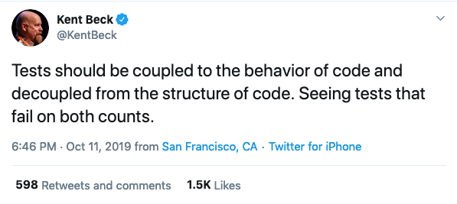
https://twitter.com/KentBeck/status/1182714083230904320
Notes:
Kent acknowledge that TDD By Example did not explicitly call out this problem of tests that are sensitive to the structure of the code – his equivalen to Meszaros’s fragile test and confusingly behavior-sensitivity. Kent means externally visible behavior, Meszaros means unobservable behavior or Kent;s structure.
Fragile Tests became the bane of much of testing. Change the contract of a Depended upon Component and spend the next few hours fixing up broken tests. This might be vaguely justifiable for a component we did not control, where the interaction with the third party component was what was under test – although I don’t think that is the way to go – it becomes nonsense when we control both the SUT and DOC

Slide 36
Refactoring (noun): a change made to the internal structure of software to make it easier to understand and cheaper to modify without changing its observable behavior.
https://martinfowler.com/bliki/DefinitionOfRefactoring.html
Notes:
But when we think about TDD, we must think about it’s cycle: Red-Green-Refactor. If Kent is the father of TDD, Martin Fowler became its godfather with his deeper explanation of refactorings - changing structure without changing the behaviour. Refactoring focuses on the implementation details, not on the behaviour of its external interface.
Changing the structure of your implementation, should not break any tests, only changing the behaviour of the SUT should. Indeed the ability to keep your tests green between steps of the refactoring is what makes refactoring ‘safe’ as opposed to re-engineering which is unsafe as it requires regression. YOUR TESTS SHOULD NOT BREAK DURING REFACTORING.

Slide 37
If the program’s behavior is stable from an observer’s perspective, no tests should change.
https://medium.com/@kentbeck_7670/programmer-test-principles-d01c064d7934
Notes:
And this implies that the tests should not need to change, if the behaviour does not change. A refactoring should not change a TDD test. Indeed the TDD test confirms that the behavior remains the same after the refactoring. It is the very heart of how our refactoring is enhanced by tests, and how we are able to refactor after we reach –green, because we have passing tests, as long as the tests keep passing our refactoring breaks nothing.

Slide 38
My personal style is I just don’t go very far down the mock path… your test is completely coupled to the implementation not the interface… of course you can’t change anything without breaking the tests
Kent Beck https://www.youtube.com/watch?v=z9quxZsLcfo
Notes:
Kent addressed this issue in his discussion of TDD with Martin Fowler and DHH in 2014. He discussed the specific problem that developers would often report fragile tests, and when he looked at them, he could see mocks returning mocks, returning mocks. The software was highly coupled to the tests – no wonder it would break tests on any chane

Slide 39
Failure of a Unit Test shall implicate one (1) and only one (1) unit. (A method, class, module, or package.)
Failure of a Programmer Test, under Test Driven Development, implicates only the most recent edit.
https://wiki.c2.com/?ProgrammerTest
https://wiki.c2.com/?DeveloperTest
Notes:
The XP Community renamed Unit Tests to Developer Tests, for use with TDD, as far back as 2010, and to Programmer Tests in 2013
Under Mezarios’s patterns n Xunit Patters, Programmer Tests are actually closer to Component Tests than Unit Tests: http://xunitpatterns.com/component%20test.html

Slide 40
Test Driven Development produces Developer Tests. The failure of a test case implicates only the developer's most recent edit. This implies that developers don't need to use Mock Objects to split all their code up into testable units. And it implies a developer may always avoid debugging by reverting that last edit.
https://wiki.c2.com/?UnitTest
Notes:
This is really just a summary: TDD tests are small-scale, programmer tests, where failure just indicates that the last edit is suspect. We can revert the change to remove the error. Defect localization is by change/edit.

Slide 41
How should the running of tests affect one another? Not at all.
Kent Beck, TDD By Example
Notes:
It is the test fixture that is the unit of isolation, not the ‘system under test’. We don’t want to tests to break each other.
This is the major constrained on so called shared fixture elements: file systems, databases etc. One test can impact another test running against a shared resource. This may create the conditions to replace with a mock or test-double so as to free up from a shared fixture
Tests need to be fast, and run independently and in-parallel

Slide 42
Avoid using mocks for anything other than issues with:
Isolated Test
Fast Test
Fragile Test
Notes:
Test isolation i.e. difficult to run in parallel or isolation
Test speed i.e. dependency is slow
Fragile Test i.e. dependency causes test to break frequently due to timing issues (often slow test too)

Slide 43
The trigger for a new test is a new function
Notes:
By function here, we mean instance method, class method, stand alone function etc. The scope is irrelevant.
Our concern is what triggers writing a test? It is often expressed that before you write a new function at any scope, you should write a test.
A lot of tutorials encourage you to write a new test for any new method that you write.

Slide 44
The trigger for a test is a new requirement
Notes:
Remember that we said we: don’t do ATDD. If we don’t separate out ATDD we can refocus on the acceptance criteria for a story driving our TDD practice instead. We have a requirement in the form of a user story, or if we prefer an agile use case, one that is elaborated later. It is the requirements for that which drive our TDD practice

Slide 45
We need to be able to add amounts in two different currencies and convert the result given a set of exchange rates.
Kent Beck, TDD By Example
Notes:
This is an example that Kent gives in TDD by example. It is literally an example of the requirement that drives testing.
We could rephrase it using a GWT syntax
Given I have two amounts of different currencies and an exchange rate table when I add the two currencies together I should be able to get a result in one of the currencies

Slide 46
The next test you write in TDD is just the most obvious step that you can make towards implementing the requirement given by a use case or user story.
Notes:
Out test are focused on moving towards completion of the use case or user story. We drive incrementally and iteratively toward the expression of that behaviour in our tests.
Does that require a single method on a class, or a single function? Perhaps. But it might require many collaborating objects. We use tests to find out.
They are programmer tests, so the SUT required does not have to be an isolated class, method of function. We can test at whatever level is appropriate.
The requirement is what matters and we go up and down in viewpoint as required, to get the requirement under test.

Slide 47
I found the shift from thinking in tests to thinking in behaviour so profound that I started to refer to TDD as BDD, or behaviour- driven development.
https://dannorth.net/introducing-bdd/
Notes:
Dan North’s famous name change originally related to this observation, that what Kent was doing was driving development through iterations of the behavior of the system, not through iterations of the implementation of the system.
For this reason he rephrased TDD as BDD

Slide 48
TDD at one-level of granularity

Slide 49
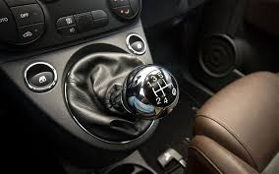
Notes:
How large should your steps be?
There are really two questions lurking here:
How much ground should each test cover?
How many intermediate stages should you go through as you refactor?
You could write the tests so they each encouraged the addition of a single line of logic and a handful of refactorings. You could write the tests so they each encouraged the addition of hundreds of lines of logic and hours of refactoring. Which should you do?
Part of the answer is that you should be able to do either. The tendency of Test-Driven Developers over time is clear, though—smaller steps. However, folks are experimenting with driving development from application-level tests, either alone or in conjunction with the programmer-level tests we've been writing.
At first when you refactor, you should be prepared to take lots of little tiny steps. Manual refactoring is prone to error, and the more errors you make and only catch later, the less likely you are to refactor. Once you've done a refactoring 20 times by hand in little tiny steps, experiment with leaving out some of the steps.
Automated refactoring accelerates refactoring enormously. What would have taken you 20 manual steps now becomes a single menu item. An order of magnitude change in quantity generally constitutes a change in quality, and this is true of automated refactoring. When you know you have the support of an excellent tool, you become much more aggressive in your refactorings, trying many more experiments to see how the code wants to be structured.
The Refactoring Browser for Smalltalk is as I write still the best refactoring tool available. Java refactoring support is appearing in many Java IDEs, and refactoring support is sure to spread quickly to other languages and environments.

Slide 50
A Walk Through Developer Testing

Slide 51
Red: Write a failing test
Green: Make the test pass
Refactor: Improve the code
TDD Cycle

Slide 52
Any live cell with two or three live neighbors survives.
Any dead cell with three live neighbors becomes a live cell.
All other live cells die in the next generation. Similarly, all other dead cells stay dead.

Slide 53
We are writing programmer tests. A failing test tells us that the last edit to the source is the source of an issue
The prompt to write a test is a new requirement. We assume that we obtained these when elaborating the story with the customer.
When we discover that we need new collaborators by refactoring we ask: are they part of our public interface or an implementation detail. We don’t test implementation details.

Slide 54
Q&A Break

Slide 55
Towards Clean Code

Slide 56
Red-Green-Refactor

Slide 57
Red-Green-Refactor
1 Red Write a little test that doesn't work, and perhaps doesn't even compile at first.
2.Green Make the test work quickly, committing whatever sins necessary in the process.
3.Refactor Eliminate all of the duplication created in merely getting the test to work.
Notes:
Write a test: We work Test First. Always.
Make it Compile: Get the test to the point of compilation, with stubbed implementations on the SUT
Run to see that it fails: The only control for a test is a failing test. Remove false positives.
Make it run: Do the simplest thing you can to implement. Don’t strive for clean code here.
Remove duplication: Now refactor to clean code.

Slide 58
Write a test.
Make it compile.
Run it to see that it fails.
Make it run.
Remove duplication.

Slide 59
Make it run. Quickly getting that bar to go to green dominates everything else.
This shift in aesthetics is hard for some experienced software engineers.
This is not just about accepting sin, its about being sinful
Write sinful code!
Notes:
Make it run. Quickly getting that bar to go to green dominates everything else. If a clean, simple solution is obvious, then type it in. If the clean, simple solution is obvious but it will take you a minute, then make a note of it and get back to the main problem, which is getting the bar green in seconds.
This shift in aesthetics is hard for some experienced software engineers. They only know how to follow the rules of good engineering. Quick green excuses all sins. But only for a moment.
The goal is clean code that works (thanks to Ron Jeffries for this pithy summary). Clean code that works is out of the reach of even the best programmers some of the time, and out of the reach of most programmers (like me) most of the time. Divide and conquer, baby. First we'll solve the “that works” part of the problem. Then we'll solve the “clean code” part. This is the opposite of architecture-driven development, where you solve “clean code” first, then scramble around trying to integrate into the design the things you learn as you solve the “that works” problem.
--------
The different phases have different purposes. They call for different styles of solution, different aesthetic viewpoints. The first three phases need to go by quickly, so we get to a known state with the new functionality. We can commit any number of sins to get there, because speed trumps design, just for that brief moment.
Now I'm worried. I've given you a license to abandon all the principles of good design. Off you go to your teams—“Kent says all that design stuff doesn't matter.” Halt. The cycle is not complete. A four-legged Aeron chair falls over. The first four steps of the cycle won't work without the fifth. Good design at good times. Make it run, make it right.

Slide 60
We can commit any number of sins to get there, because speed trumps design, just for that brief moment.
Kent Beck, TDD by Example

Slide 61
Good design at good times. Make it run, make it right.
Kent Beck, TDD by Example

Slide 62
The Refactoring Step is when we produce clean code.
It’s when you remove duplication [Beck]
It’s when you sanitize the code smells. [Fowler]
It’s when you apply patterns [Kerievsky].
Notes:
Now there is an important implication here that is often overlooked. We don’t have to write tests for the classes that we refactor out through that last step. They will be internal to our implementation, and are already covered by the first test. We do not need to add new tests for the next level – unless we feel we do not know how to navigate to the next step.
One issue here is the difference between refactoring into objects and introducing collaborators, that we potentially should be replacing with a test double (see later) for the test. If we introduce another public class it is probably a collaborator which we ought to consider might need to be replaced with a test double. We don’t want to write new tests to implement it at this stage. Instead we just want to check the outputs to that class.
Note that the easy way to test this assertion is that when we refactor we only change implementation details not public contracts. If we introduce a new public contract we may want to replace it with a test.
Another corollary is that what we have our test green we should not need alter our test for changes to the implementation. If we suddenly need to introduce new public objects, it implies that our test is wrong and we have missed a collaborator.
Be careful with this, you need to consider what is public. Really only our adapters need to be public, but we often make top level domain objects public too for reasons of packaging, such as aggregates. Don’t bother to mock the public domain object if the only caller is the adapter. You are probably mocking everything else in the adapter anyway, and the adapter is simply providing a way for your port – tests in this instance – but framework code in the production system to access your code. In addition, in a domain model, instead of directly calling another aggregate we often prefer to raise an event, because we exit a consistency boundary, and also need to load new state from the Db. In this case you are not checking that you call another role, but that you raise a message correctly. However, it is likely you will mock this event being raised.
Be wary of making things public. Again this is a dependency issue. Anything that is public has dependencies. Dependencies resist change and anything that makes it harder to change our software makes it brittle and can lead to Banyan Tree or Big Ball of Mud anti-patterns
Refactor to patterns, keep implementations private, test the public contract only.

Slide 63
Pattern | Test Writing | Refactoring
Command |  | X
Value Object |  | X
Null Object |  | X
Template Method |  | X
Pluggable Object |  | X
Pluggable Selector |  | X
Factory Method | X | X
Imposter | X | X
Composite | X | X
Collecting Parameter | X | X
Kent Beck, TDD By Example
Notes:
Kent Beck’s Table from Test Driven Development showing that patterns are targets of the refactoring step

Slide 64
You do not write new unit tests when refactoring to clean code.
You are not introducing public classes.
It is likely if you feel the need to introduce a new public class, you may need collaborators that fulfill a role.

Slide 65
A Walk Through Refactoring

Slide 66
Clean Architecture

Slide 67
Clean Architecture

Slide 68
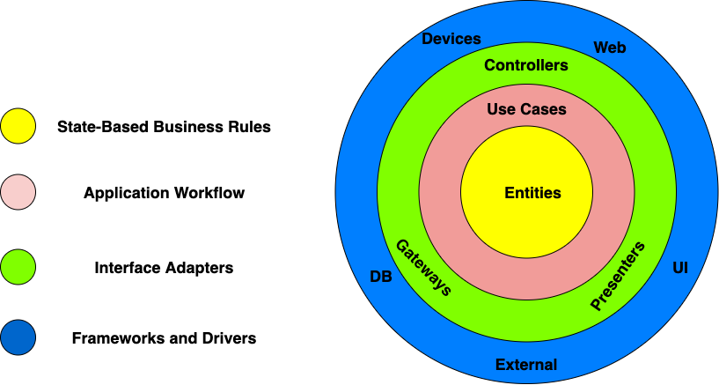

Slide 69
Request Model
Entity
Entity
Interactor
<<interface>>
Entity
Delivery Mechanism
Boundary
Entity
Use Cases
Response Model
Entity Gateway
<<interface>>
Data Structure
Frameworks & Drivers
Interface Adapters
Notes:
The Request Model is a pure data structure, it has no behavior. It comes through the boundary and it reaches the Interactor, that is named not Interactor, but for the use case. The Interactor goes and finds the Entities, calls the appropriate methods, and then gathers the Response Model from the data.
It sounds like HTTP Request-Response, but there is no HTTP.
To Test: Create the Interactor, Create The Request Model, Run the Interactor and check the Response Model.
You have no dependency on the delivery mechanism. In fact the delivery mechanism depends on you, the application controller, which is your plugin into the framework and implements an interface

Slide 70
Our tests are just another adapter
We write tests against use cases
Notes:
This is the use case it is where we drive code

Slide 71
Request Model
Entity
Entity
Interactor
<<interface>>
Entity
XUnit
Framework
Test
Entity
Use Cases
Response Model
Entity Gateway
<<interface>>
Data Structure
Frameworks & Drivers
Delivery Mechanism
Interface Adapters
In-Memory
DB
Notes:
How do we talk to the Db. We implement the interface with a concrete boundary component that talks to the DB

Slide 72
Request Model
AsyncRequestHandler
Entity
Entity
IHandleRequests
<<interface>>
Entity
XUnit
Framework
Test
Entity
Use Cases
Response Model
Entity Gateway
<<interface>>
Data Structure
Frameworks & Drivers
Delivery Mechanism
Interface Adapters
In-Memory
DB
Notes:
How do we talk to the Db. We implement the interface with a concrete boundary component that talks to the DB

Slide 73
We don’t write tests against the adapter
Our tests are just another adapter
Notes:
Adapter can change; we are not driving behaviour here, just hooking up

Slide 74
We write system tests for acceptance

Slide 75
A Walk Through Clean Architecture

Slide 76
Are We Done Yet?

Slide 77
Fallacies and Principles

Slide 78
Customers write Acceptance Tests
Notes:
When engineers talk about TDD, they often associate it with the idea of a developer writing a unit test.
This fallacy has led to many of the problems with how TDD is practiced.

Slide 79
Originally called Functional Tests because each acceptance test tries to test the functionality of a user story.
Acceptance tests are different [is] modeled and possibly even written by the customer. ...Hence the even-newer name, Customer Test.
https://wiki.c2.com/?AcceptanceTest
Notes:
Early on XP privileged the idea of the on-site customer. XP recognized that the benefit of agile came from ‘shortening the feedback loop’ and it promoted the idea of the on-site customer for that. A user-story was just a place holder to have a conversation with a customer about a requirement. When pulled from the backlog, the team designed the solution to meet acceptance criteria defined by the customer. Those criteria were codified by the Given-When-Then pattern.
Supposedly tools like Cucumber. Fit/Fitnesse, RSpec empowered Customers to write the tests instead of Developers. This involvement of the Customer with the specification of the test was seen as the holy grail – quality at the front of the line – rather than catch bugs when the customer reviewed at the beginning of the line, we would catch them at the end

Slide 80
These two problems--that customers don't participate, which eliminates the purpose of acceptance testing, and that they create a significant maintenance burden, means that acceptance testing isn't worth the cost. I no longer use it or recommend it.
James Shore, http://www.jamesshore.com/Blog/The-Problems-With-Acceptance-Testing.html
Notes:
James Shore was one of the authors of FIT. FIT was a tool for writing Customer Tests in a way that Customers could at least read, if not write themselves. FIT was table driven, using HTML tables to encode tests. These tables could then be parsed and used to provide parameters to test methods.
The idea was that customers could play with the tool, typing in numbers, seeing the effects.
The limitations of table-driven testslet some to create DSL customer tools that looked like natural language, such as Cucumber. The idea was that these drove not only the parameters to the tests, but the ubiquitous language used by customer and developers.
In reality this approach was problematic:
Customers were hard-pressed to write acceptance criteria in a Table or GWT style – it generally required a requirements gathering session
Customers rarely if ever reviewed the tests to examine an executable specification for the software
Tests are mostly red, because new tests do not go green until the end of the iteration. This means that tests break and no one fixes them until all the stories pass at the end of the iteration – which moves us into testing outside the iteration boundary with no real notion of Done-Done
Tests require an extra level of indirection for developers who have to turn the DSL into executing code.
They are fragile when changed
They rarely run in under 2 mins, so they fail the fast property and are only executed at integration, again more time spent red.
FIT was really intended for domain exploration, but ended up an end-to-end integration testing tool
I have used them and pushed teams to use them, despite resistance. They spend most of their time red unless we downed tools to ‘fix’ them and provided little value as customers never reviewed them.

Slide 81
Customers illustrate their descriptions with concrete examples…programmers use these examples to guide their work…Sometimes [programmers] use the examples directly in their tests…More often…programmers use the examples as a guide, writing a multitude of more focused, programmer-centric tests as they use TDD
https://www.jamesshore.com/v2/blog/2010/alternatives-to-acceptance-testing
Notes:
We still like the idea that the customer participates in specification, when we expand on the requirements in the user story. The user story is still a ‘promise for conversation’ and in the elaboration step we do design. We discuss the acceptance criteria, the requirements defined as tests: what are we building, and how we will build it, the architecture of our implementation.
This discussion should be recorded, but it can be done in markdown or text, and little more structure than Given-When-Then. It does not have to be automated, it can be turned into automated tests by developers, in the same way any design decision are translated into code at the last responsible moment
Acceptance criteria inform unit tests over driving automated acceptance tests.

Slide 82
TDD should create tests that can be read, so that others can understand the requirements

Slide 83
ATDD is perilous because it implies that TDD does not deal with the acceptance criteria for stories
Notes:
Perhaps most of all, ATDD has rotted our TDD practice, because it implies that the focus of TDD is not on the acceptance criteria for a story, but on the granular implementation of details of an ATDD test. This has reduced TDD from the driver of acceptance criteria to a secondary practice when it encompassed the exploration of that criteria originally.
ATDD exists because people who misunderstood TDD realized that we need acceptance criteria for stories and because they were no longer using TDD to drive that, they were forced to invent ATDD to do it, justifying it on the basis of a customer involvement in using ATDD tools that was rarely if ever realized.

Slide 84
It doesn’t matter if you are test first or test last
Notes:
When engineers talk about TDD, they often associate it with the idea of a developer writing a unit test.
This fallacy has led to many of the problems with how TDD is practiced.

Slide 85
You need a way to think about design, you need a method for scope control
Kent Beck, TDD By Example
Notes:
When we think about TDD, it is easy to think just about the regression value of tests. If I have a test suite then I can refactor code easily.
But TDD is more than that, particularly in an agile context. And part of this is a failure to engage with what the Red phase of Red-Green-Refactor does.
When we write tests in the Red step we are pretotyping the interface that our SUT should have. What expresses the use case or use story requirements that we have. How does a consumer of that code explore an API that surfaces how the requirement is implemented
It also means that we write code that is driven by a requirement from a user story. We don’t write speculative code that we think we might be needed, only code that is needed because of the actual requirements.
Unneeded code violates the time value of money. We should write it when we need it, if we need, when we understand the actual requirement, not ahead of time.
There is a tendency when we test last to experience rework because however good our implementation was, it was not what the user actually asked for.

Slide 86
When we write a test, we imagine the perfect interface for our operation. We are telling ourselves a story about how the operation will look from the outside.
Kent Beck, TDD By Example
Notes:
Tests drive the API of the SUT, they are design-by-contract for the implementation of the user story

Slide 87
If you are struggling to write a test, because the acceptance criteria for the story are not clear – TDD is working
Notes:
TDD should force us to understand the requirements, and document our understanding is a test. If we don’t know what the criteria are – we should be asking, not writing code.
TDD surfaces requirements.

Slide 88
One of the hardest things to communicate about test-driven development is the mental state that it
puts you in.
Martin Fowler in Kent Beck, TDD By Example
Notes:
TDD s a rhythm for doing work. It answers the question ‘where do I start” when tackling a requirement: you start with a test. It builds increasing confidence: my code continues to work as it begins to accrete more and more behaviours. It manages anxiety: focus on this test, not everything.
As someone with ADHD I find TDD immensely helpful: write a Test List (all the things I need to do, keep adding to it as I think of new ones) but focus on this test now, not everything else.

Slide 89
You want 100% test coverage of your code
Notes:
When engineers talk about TDD, they often associate it with the idea of a developer writing a unit test.
This fallacy has led to many of the problems with how TDD is practiced.

Slide 90
If we test first, we don’t end up with speculative code.
Notes:
It is true to say that when we write a test, we should not end up with unneeded code, so all the code that appears in response to our test, should be under test.

Slide 91
We should not introduce new paths in refactoring, we need a new test.
Notes:
It also true to say that we can use a code coverage tool to ensure that our refactoring step does not introduce a new path, that has not been covered by an existing test. A refactoring should be safe steps that does not introduce new code, but we are human, we get carried away and we accidentally drop in a path that is not tested. Now we know what our next test to write is – one that exercises that path, if it is a requirement, or to revert the change if that was not a requirement

Slide 92
But not all of our code should be driven by TDD
Notes:
TDD is not good for all of our code
TDD works best on the domain.

Slide 93
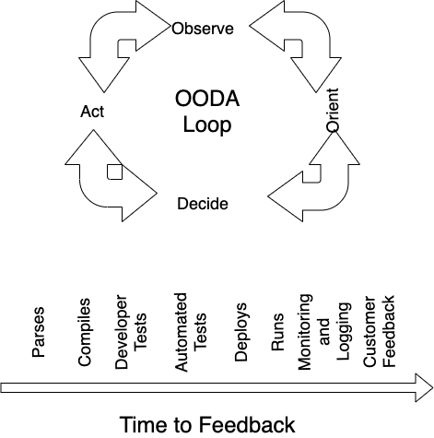
Notes:
We get feedback during development using an OODA Loop. The feedback helps us ‘observe’ our current position, look around and see what the next thing we need to do is, choose it, and then act, then get feedback.
Short feedback loops help us move faster. A parser tells us our code is wrong in the IDE before we compile. The compiler tells us it cannot turn it into software. Developer tests tell us if we are moving toward the requirement. Automated tests keep us working. Deployment tells us if we can make the software available. Runs tells us if someone can use it, monitoring about what happens when it is used, and customer feedback about whether it works.
Quick feedback helps us be more productive – agile is mainly about shortening how long this cycle is.

Slide 94
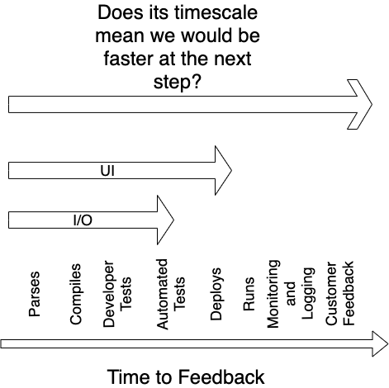
Notes:
The question then arises – if something is too slow to get feedback for, in that step?
TDD is done in short steps, that we can measure in minutes of development time, and with tests that run in seconds. If something takes a long time to test this way, it may not be a good candidate for TDD
Code that exercises a Db that must be setup before each test and torn down. Code that must interact with the network will be slow. Code that interacts with the file system.
In this case we may well want to use a test double for TDD, and automated testing (i.e. not test first around our code that proves that the concrete implementation continues to work0.
But beware that our investment here, with a good CD approach, might be slower to write those tests and run them (such as UI) than to deploy monitor and rollback.
What gives us the fastest and most complete feedback?

Slide 95
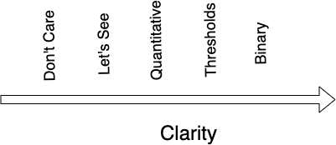

Notes:
TDD gives binary feedback. Red/Green does this pass or not. That is the clearest form of feedback. Other forms of feedback take time to understand, so are slower.

Slide 96
TDD is for fast binary feedback.
It works best where we can develop in short cycles.
If the feedback is not quick, consider another method to confirm
This is where we use a test double
Notes:
TDD is not good for all of our code
TDD works best on the domain.

Slide 97
Don’t drive visual output
Don’t drive a spike or other throwaway code
Don’t drive integration
Don’t drive 3rd party code
Notes:
TDD of a UI is difficult, partially because it is difficult to dive the UI code, but also because the UI is not being explored by the tests. Normally you have a design somewhere for how the UI looks, and what happens when the user interacts with that. There are usually automation tools that can confirm you meet that. If you have the UX then TDD is not going to help you develop it. Yu can automate confirmation of the requirements, but you can’t drive the design here.
Arguably, you don’t drive the design of an external API this way either – instead you design in something like OpenAPI and discuss it with stakeholders. You may automate that with consumer drive contracts
TDD can be used to an spike a problem or explore an SDK, but it is a lot of overhead for something that is really: read the documentation, try something, and see what happens. I would tend to use a REPL or test harness over TDD, and once I had understood how it works, come back to TDD something with it.
TDD should not be used to check 3rd party code such as frameworks or SDKs. Assume they have their own tests
TDD should not be used to drive integration, particularly with a distributed system. The tests will be fragile. Wrap that in a Gateway, hide it from user code. Automate the testing of it, perhaps with test last, but TDD won’t help you discover how to write the code or implement it.
Later on we will look at the help architecture could give us

Slide 98
A Walk Through Acceptance Testing

Slide 99
A Walk Through Developer Testing

Slide 100
First, Last and Everything

Slide 101
Fallacies and Principles

Slide 102
TDD is not necessary
Notes:
TDD is necessary, but not sufficient. As a tool for supporting programmer development of code it leaves a test artefact that can be used to ensure that the code continues to meet requirements.
But because we often don’t want to drive with TDD visual elements, integrations with 3rd party services, third party SDKs etc. there is always a ‘gap’.

Slide 103
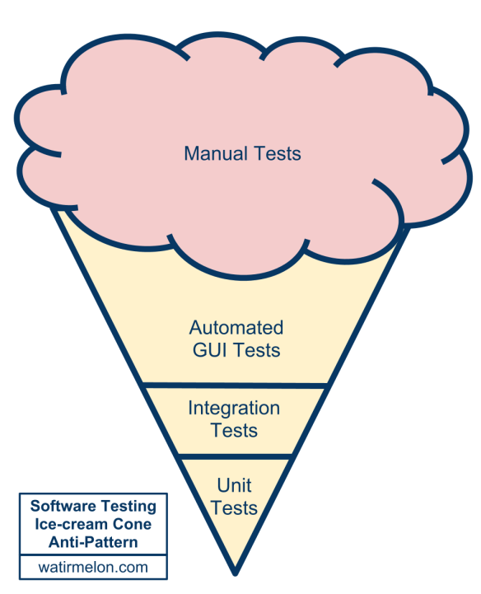
Notes:
An inverted pyramid, too much emphasis on the wrong tests.
Manual Tests
Expensive and give poor feedback. It may take days to run a manual regression pack which gives poor feedback to developers trying to determine what features caused an issue
Automated Gui Tests
Let’s skip for a moment the middle of the test automation pyramid and jump right to the top; the user interface level. Automated user interface testing is placed at the top of the test automation pyramid because we want to do as little of it as possible. We want this because user interface tests often have the following negative attributes:
* Brittle. A small change in the user interface can break many tests. When this is repeated many times over the course of a project, teams simply give up and stop correcting tests every time the user interface changes.
* Expensive to write. A quick capture-and-playback approach to recording user interface tests can work, but tests recorded this way are usually the most brittle. Writing a good user interface test that will remain useful and valid takes time.
Time consuming. Tests run through the user interface often take a long time to run. I’ve seen numerous teams with impressive suites of automated user interface tests that take so long to run they cannot be run every night, much less multiple times per day.
For much of my career test automation meant tests that drove an application through its user-interface. Such tools would often provide the facility to record an interaction with the application and then allow you to play back that interaction, checking that the application returned the same results. Such an approach works well initially. It's easy to record tests, and the tests can be recorded by people with no knowledge of programming.
But this kind of approach quickly runs into trouble, becoming an ice-cream cone. Testing through the UI like this is slow, increasing build times. Often it requires installed licences for the test automation software, which means it can only be done on particular machines. Usually these cannot easily be run in a "headless" mode, monitored by scripts to put in a proper deployment pipeline.
Most importantly such tests are very brittle. An enhancement to the system can easily end up breaking lots of such tests, which then have to be re-recorded. You can reduce this problem by abandoning record-playback tools, but that makes the tests harder to write. [1] Even with good practices on writing them, end-to-end tests are more prone to non-determinism problems, which can undermine trust in them. In short, tests that run end-to-end through the UI are: brittle, expensive to write, and time consuming to run. So the pyramid argues that you should do much more automated testing through unit tests than you should through traditional GUI based testing.
In addition, consider that in the ice-cream cone, the weight of tests is on the adapter – a component that we want to throw away to cope with technological change. If we write automation tests against our WebForms UI what happens when we decide to re-write as a SPA. The simple answer is that we are forced to throw away our tests along with the adapter!

Slide 104
TDD is sufficient
Notes:
TDD is necessary, but not sufficient. As a tool for supporting programmer development of code it leaves a test artefact that can be used to ensure that the code continues to meet requirements.
But because we often don’t want to drive with TDD visual elements, integrations with 3rd party services, third party SDKs etc. there is always a ‘gap’.

Slide 105
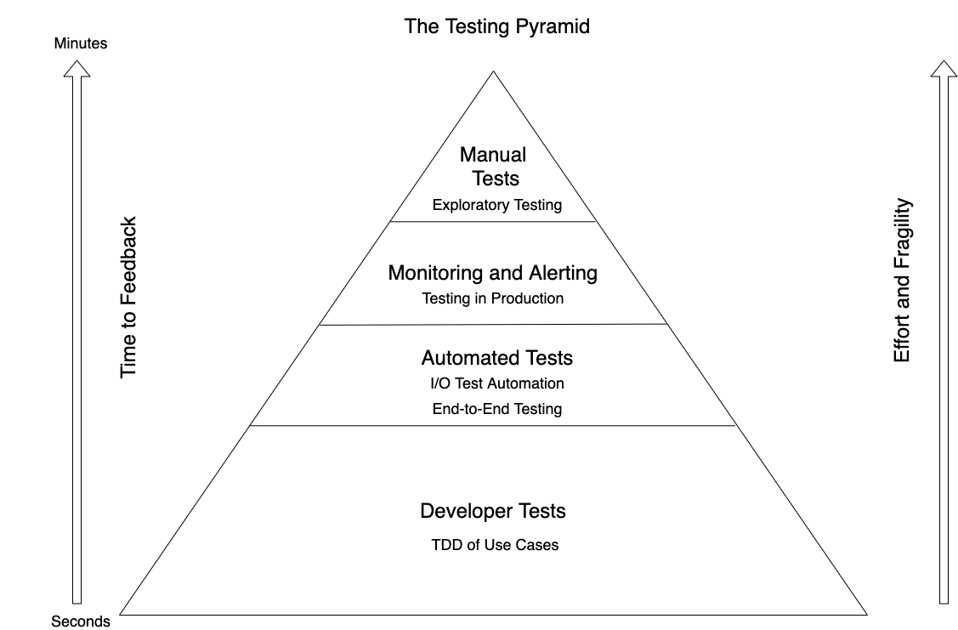
Notes:
An inverted pyramid, too much emphasis on the wrong tests.
Manual Tests
Expensive and give poor feedback. It may take days to run a manual regression pack which gives poor feedback to developers trying to determine what features caused an issue
Automated Gui Tests
Let’s skip for a moment the middle of the test automation pyramid and jump right to the top; the user interface level. Automated user interface testing is placed at the top of the test automation pyramid because we want to do as little of it as possible. We want this because user interface tests often have the following negative attributes:
* Brittle. A small change in the user interface can break many tests. When this is repeated many times over the course of a project, teams simply give up and stop correcting tests every time the user interface changes.
* Expensive to write. A quick capture-and-playback approach to recording user interface tests can work, but tests recorded this way are usually the most brittle. Writing a good user interface test that will remain useful and valid takes time.
Time consuming. Tests run through the user interface often take a long time to run. I’ve seen numerous teams with impressive suites of automated user interface tests that take so long to run they cannot be run every night, much less multiple times per day.
For much of my career test automation meant tests that drove an application through its user-interface. Such tools would often provide the facility to record an interaction with the application and then allow you to play back that interaction, checking that the application returned the same results. Such an approach works well initially. It's easy to record tests, and the tests can be recorded by people with no knowledge of programming.
But this kind of approach quickly runs into trouble, becoming an ice-cream cone. Testing through the UI like this is slow, increasing build times. Often it requires installed licences for the test automation software, which means it can only be done on particular machines. Usually these cannot easily be run in a "headless" mode, monitored by scripts to put in a proper deployment pipeline.
Most importantly such tests are very brittle. An enhancement to the system can easily end up breaking lots of such tests, which then have to be re-recorded. You can reduce this problem by abandoning record-playback tools, but that makes the tests harder to write. [1] Even with good practices on writing them, end-to-end tests are more prone to non-determinism problems, which can undermine trust in them. In short, tests that run end-to-end through the UI are: brittle, expensive to write, and time consuming to run. So the pyramid argues that you should do much more automated testing through unit tests than you should through traditional GUI based testing.
In addition, consider that in the ice-cream cone, the weight of tests is on the adapter – a component that we want to throw away to cope with technological change. If we write automation tests against our WebForms UI what happens when we decide to re-write as a SPA. The simple answer is that we are forced to throw away our tests along with the adapter!

Slide 106
Need to do other forms of testing
Notes:
Test Pyramid

Slide 107
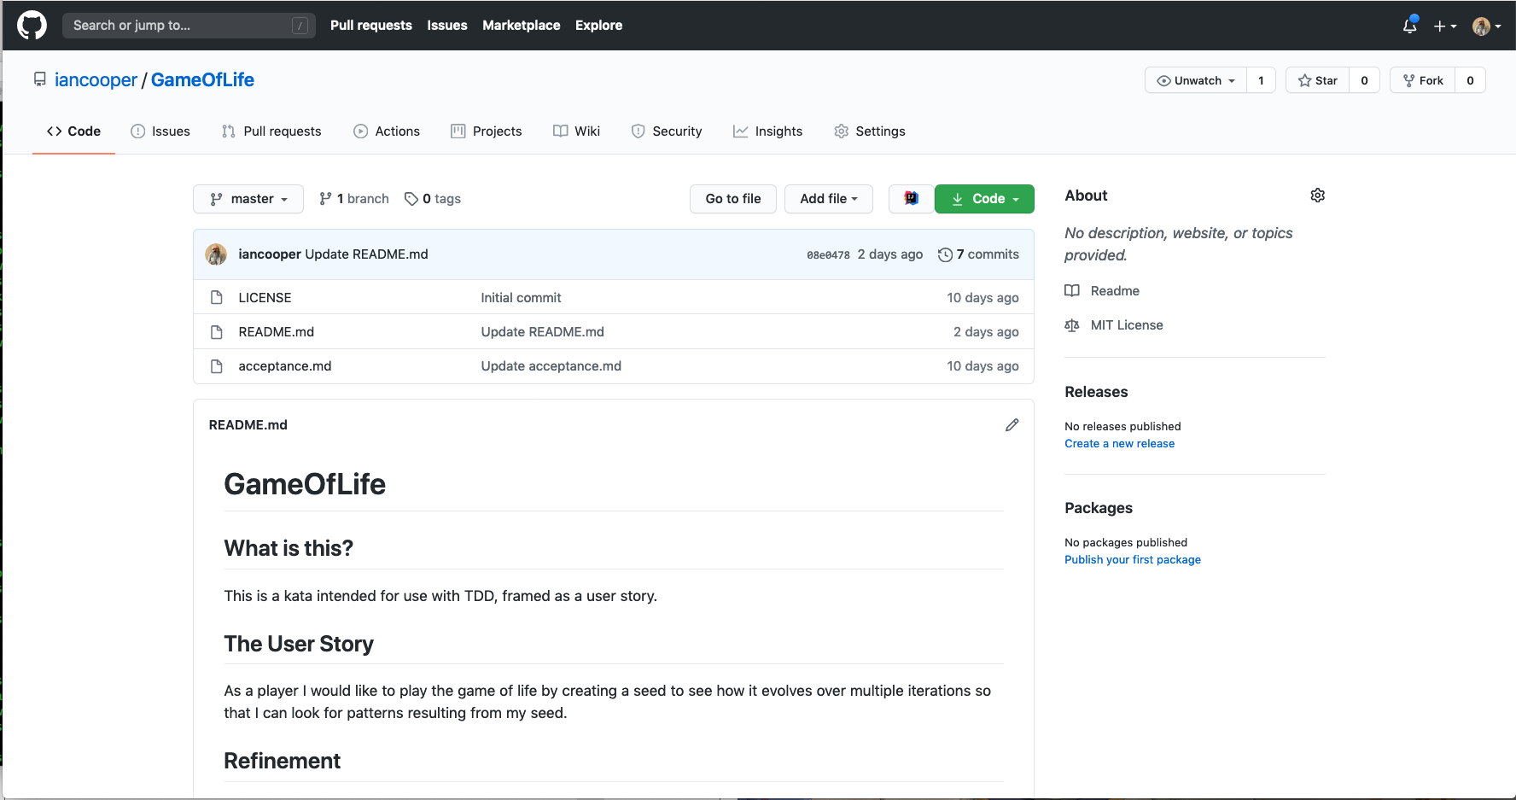
https://github.com/iancooper/GameOfLife
Notes:
Test Pyramid

Slide 108
Q&A Break

Slide 109
Kata

Slide 110
Summary

Slide 111
1: Developers write Unit Tests
2: Customers write Acceptance Tests
3: The trigger for a new test is a new function
4: It doesn’t matter if you are test first or test last
5: You want 100% test coverage of your code
6: TDD is sufficient

Slide 112
1:Respond to behavior changes
2: Not respond to structure changes
3: Should be Fast
4: Should not be fragile
5: Cheap to write
6: Easy to read
7: Easy to change
https://medium.com/@kentbeck_7670/programmer-test-principles-d01c064d7934

Slide 113
Bibliography

Slide 114

Notes:
So I went back to look at the source, to see what was said.
Kent Beck introduced TDD to the world with his book, TDD By Example in 2002. It had been in use on XP teams such as the Chrysler C3 team
I was surprised, for a book that had been published at the point most of us were beginning to use TDD, how complete it was. It covered topics that I only thought emerged later, such as patterns, mocks etc. I appreciated that later books had misunderstood its message, and I wanted to communicate that any experienced practitioner should read this book and learn its lessons
It is simple and elegant.
It covers the essentials of TDD, which have been misunderstood by many since.
It covers more than just the basics with topics on patterns, smells, mocks etc.
Good later work builds on it, but too much later work just misunderstands it
The goal here is to go back and talk about it
And then look at folks who built on it

Slide 115

Notes:
This book uses 99 bottles of beer to teach you about TDD and refactoring. It is an excellent book on how to use TDD to avoid over-design and clear approaches to refactoring.

Slide 116
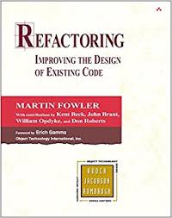
Notes:
Key idea: We refactor implementation details, not the public interface, because the latter is not ‘safe’
** Dev Express refactoring tools originally didn’t allow you to refactor public methods on public classes, because they were ‘unsafe’. Later they let you choose an ‘unsafe refactoring’ where you assumed that your solution contained all the code that consumed that API, so that operations like renaming could go ahead.

Slide 117
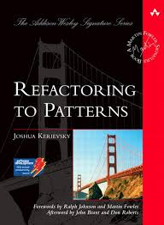
Notes:
Joshua Kerievsky identified patterns as guidance for how we refactor.
We don’t try to implement patterns in the SUT – the test focuses on requirements and is likely aimed at defining a contract.
We implement patterns as improvements to the code in the refactoring step.
This prevents folks becoming ‘pattern happy’. Patterns emerge as the solutions to refactoring sinful code into clean code.
What would Jesus do? He’d sin then ask the god of patterns for forgiveness.

